Slide 1
Software Engineering and Architecture
Containers - Docker
Lightweight Virtual Machines

Slide 2
From Dev to Ops
We have this wonderful client-server system developed
  Lots of unit and integrations tests, highly flexible, highly reliable
But we only have it on our local laptops
  Git clone, gradle something
We need to make it run in production
  Deployment idriftsættelse
Requires
  A) A computer with DNS name on the ‘big internet’
  B) Get our executable system on to that machine
Development
Operations

Slide 3
The Old Way
… a manual procedure
Buy a server farm or Rent a VM in the cloud
Ah – we need a database for the server
  Rent one more machine; install linux, install MySQL, copy
  table init scripts, configure linux for database systems, …
Now, log into the server
  Install linux, git, java, gradle, …
  Git clone the repository
  Run the executable using ‘parameters for production’

Slide 4
But it does not scale…
… Imagine 10.000+ machines to do that on ☹
  And imagine that 100 persons handles 100 machines each, each doing it in a slightly different way
  In one year, you have 10.000 machines configured in about 500 different ways, meaning any update/fix of the software requires different actions for each machine ☹
The multiple maintenance problem for operations
  Not multiple copies of code, but of machine configurations !

Slide 5
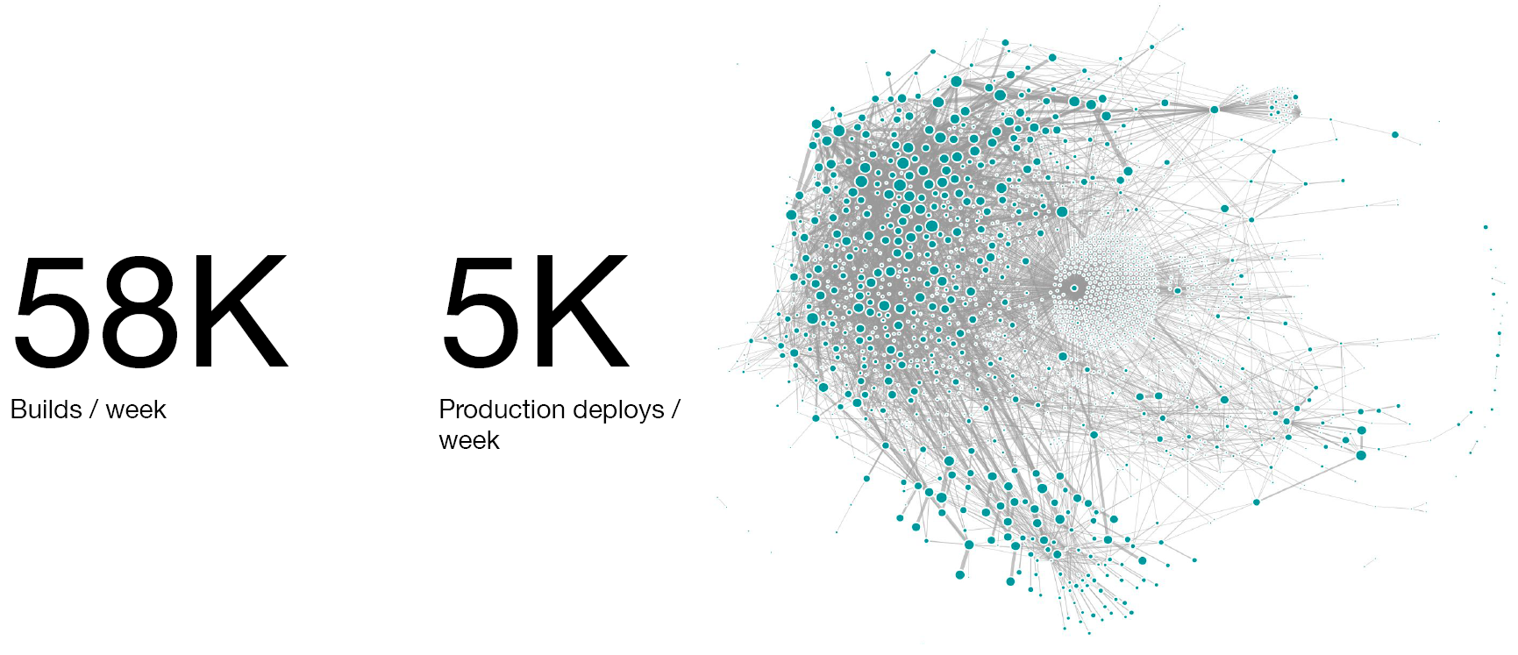
Example: Uber
~100.000 VMs to run the Uber infrastructure…

Slide 6
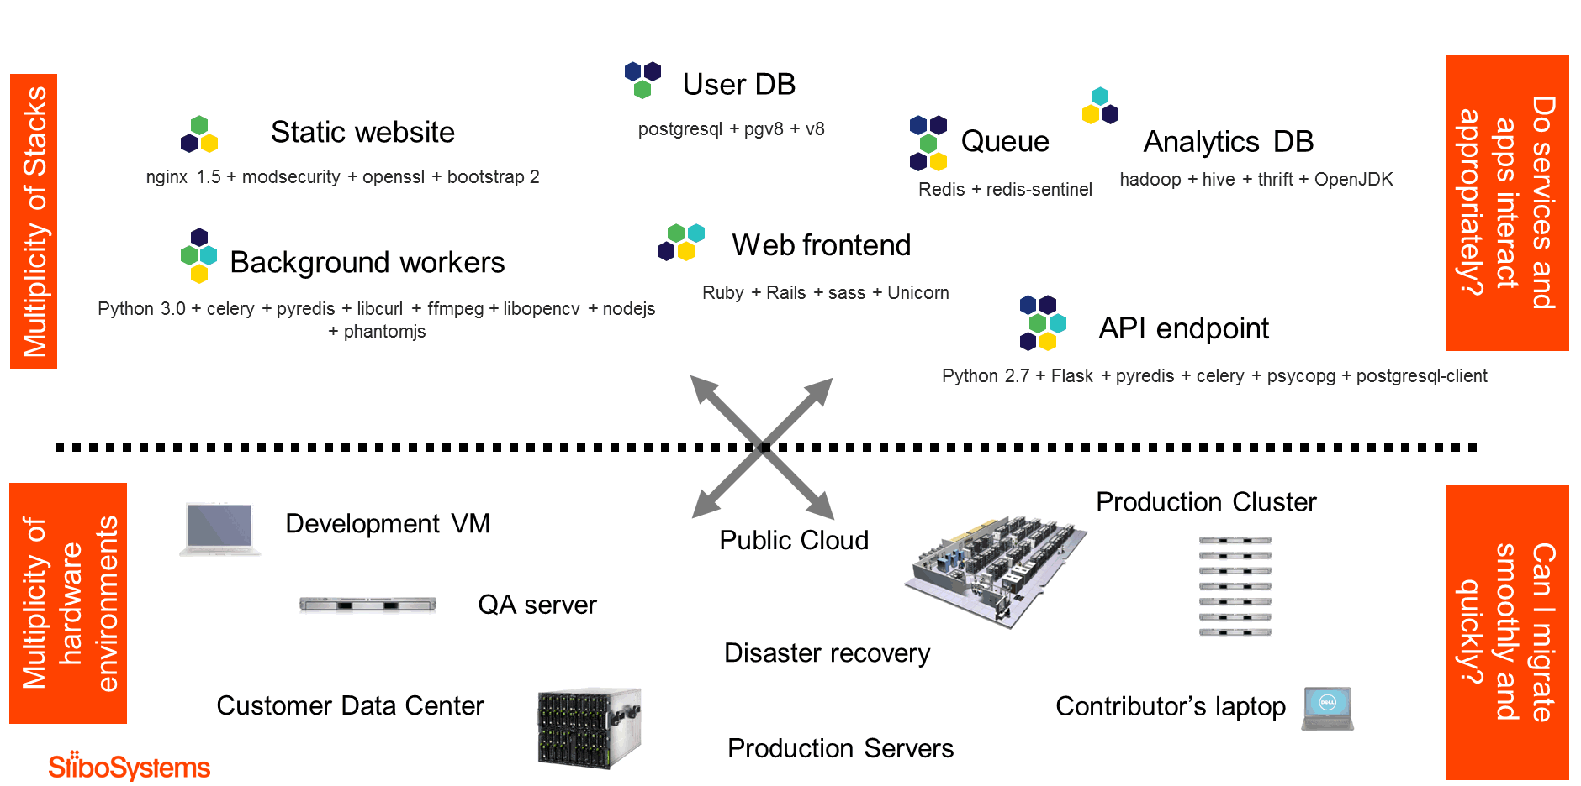
The Moving Code Problem
Crossing boundaries, that is, moving code
Source: Torben Haagh, StiboSystems

Slide 7
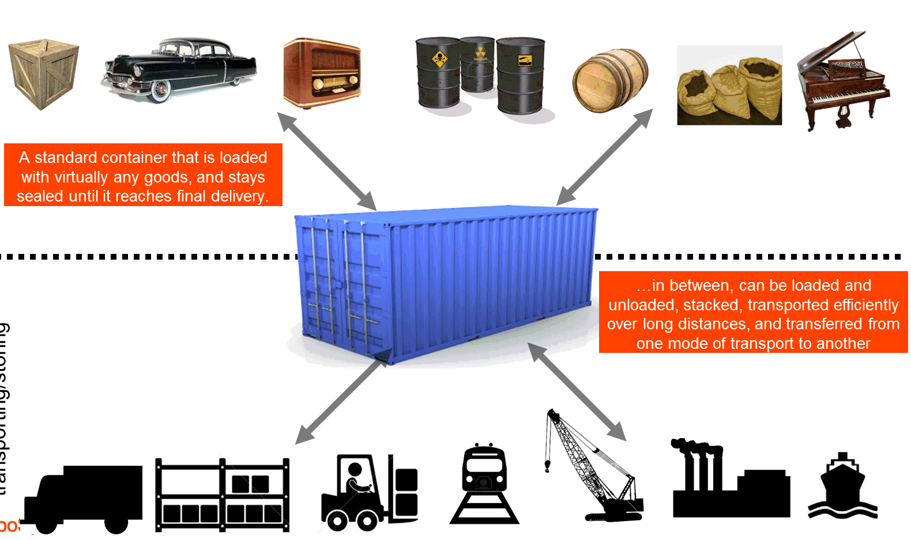
Was Solved in 1960’ies

Slide 8
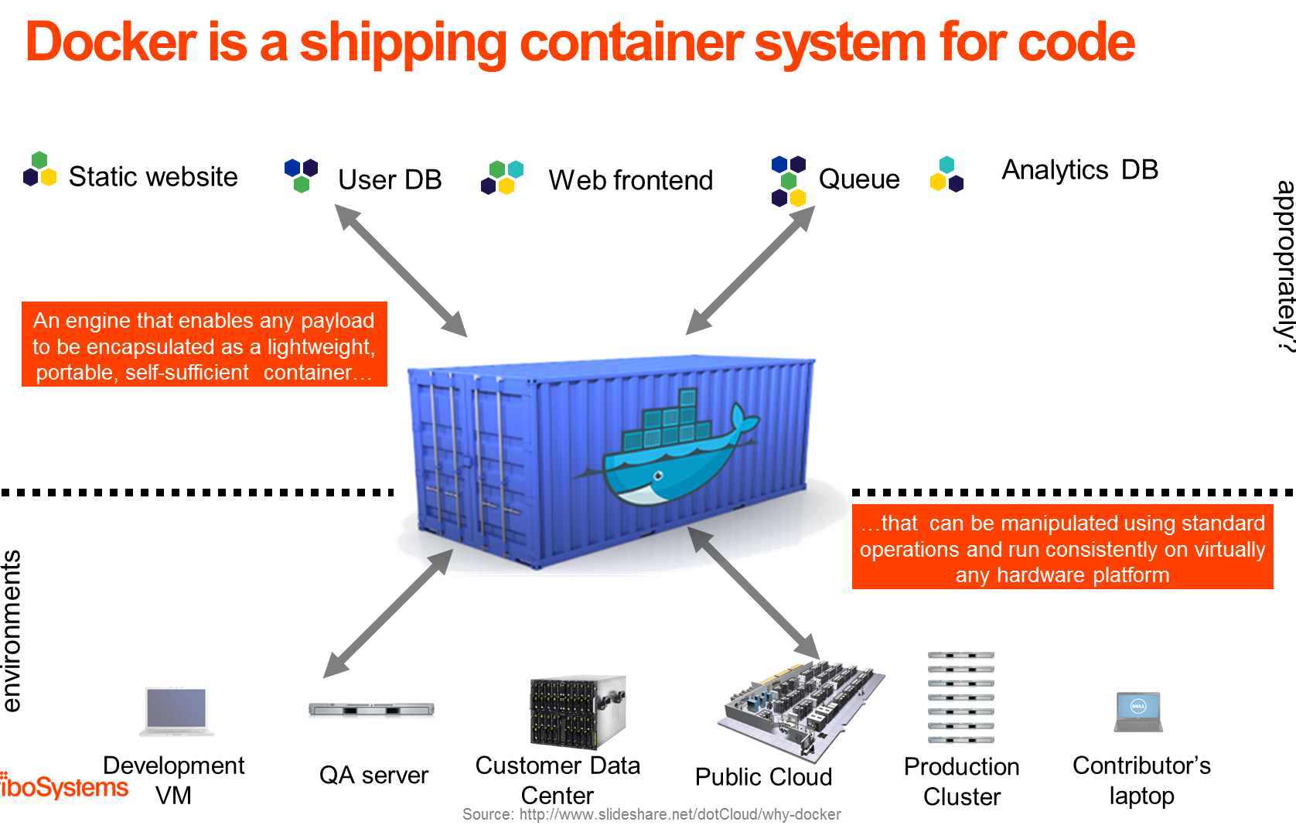
Docker = Container

Slide 9
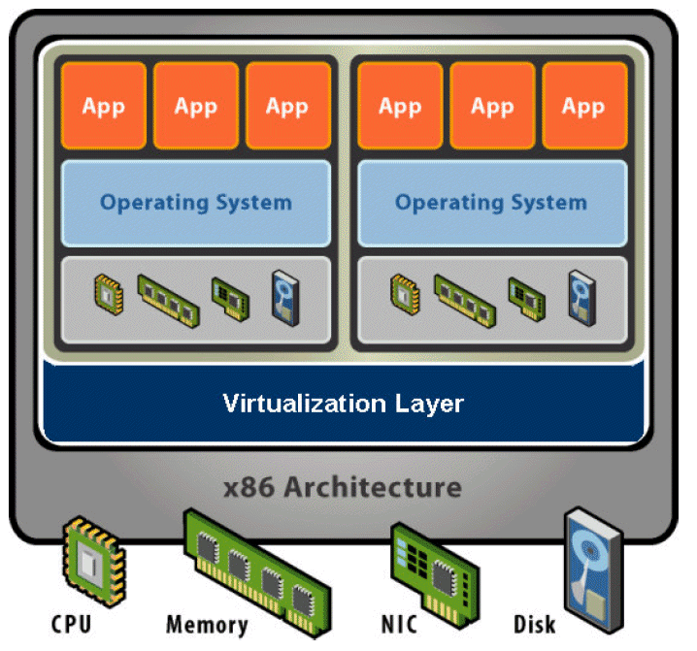
Not Just Programs - Environments
A Container is a Virtual Machine
  A VM is
    The operating system
    All supporting libraries
    The executable / system
That is:
  The code
  + the full environment of
  the (virtual) machine
  It is self-contained! No
  external dependencies!

Slide 10

So – What do We Get?
Instead of your specific labtop which is
  Lots of programs and your specific configuration of OS
  And then HotStone (server) manually fiddled to make it run
… we instead build a container which
  Includes the OS + all supporting libraries + HotStone code
That can be run on a “bare metal” computer that has no specific configuration
  Except – it of course must be able to run containers:
Docker Engine
  A program to deploy/monitor a set of Docker containers

Slide 11
Solves Scaling Issue
Problem solved:
  We rent 10.000 identical machines with no special configuration
    (that runs docker engine, ok)
  And then deploy containers with our code in.

Slide 12
Building a Container
Infrastructure-as-code
“IaC”

Slide 13
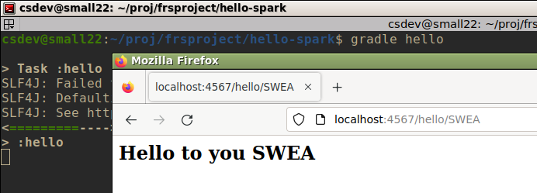
Example: Hello-Javalin
The most basic web server system
  ‘gradle hello’
    Starts a web server on port 4567
  Browse to ‘(servername):4567/hello/(a name here)’
Notes:
Frsproject/hello-javalin

Slide 14
My Container…
I want to build a docker container which contains
  Linux Operating System
  Java 25 runtime system
  Gradle v9.2
  And my Hello-Javalin code
    build.gradle
    src/ folder
Can run on any machine in the world if it has docker engine installed and nothing else required!

Slide 15
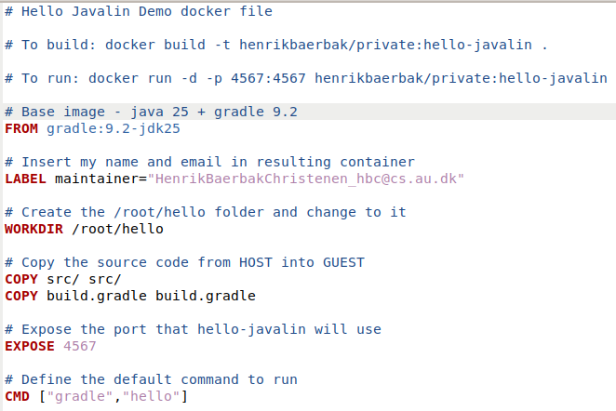
Building Containers
Infrastructure-as-code, IaC
We write code to build
the container
  Dockerfile
    A DSL for building
    Docker images
Image = Static unit
Container = Runtime unit

Slide 16
IaC
Parts:
  Base
  Copy
  Execution

Slide 17
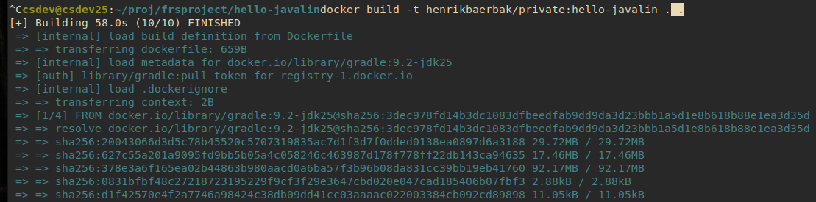
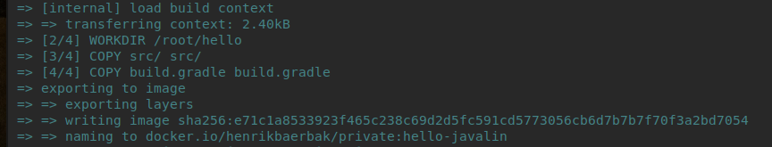
Building
Image name: henrikbaerbak/private:hello-javalin

Slide 18
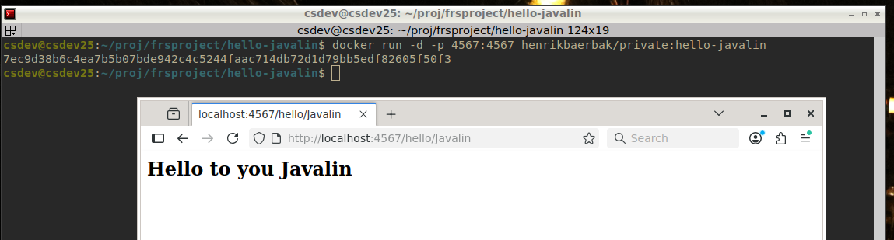
Local Running/Testing
‘run’
  -p 4567:4567 The container’s port is mapped to localhost
  -d In the background (daemon)

Slide 19
Deployment
Via Docker Hub

Slide 20
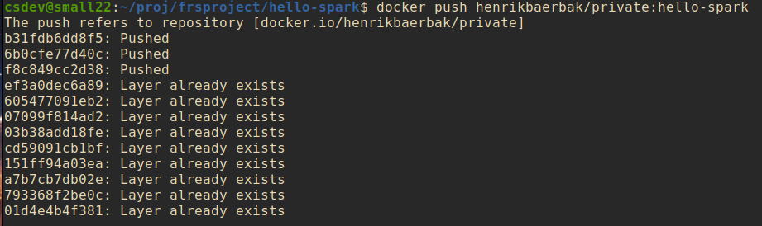
Hub
Maven Repository is a cloud service hosting java libraries
Docker hub does the same for images!
  Push to my ‘henrikbaerbak’ account on docker hub.
Now it is globally accessible !

Slide 21
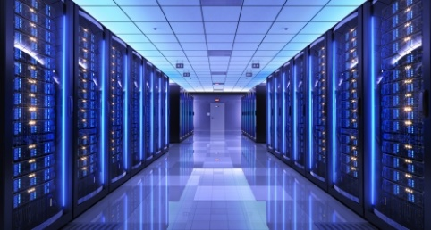
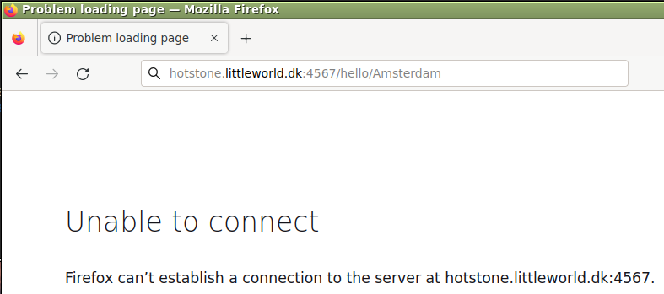
To Helsinki
I want to deploy it on my rented machine
in Helsinki
  Which has DNS ‘hotstone.littleworld.dk’

Slide 22
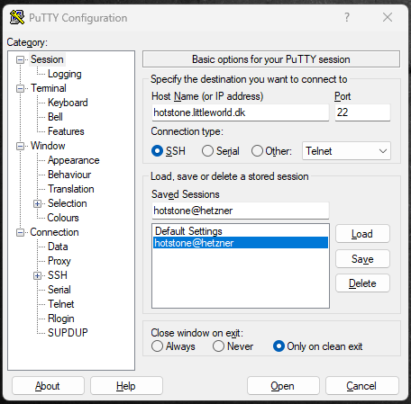
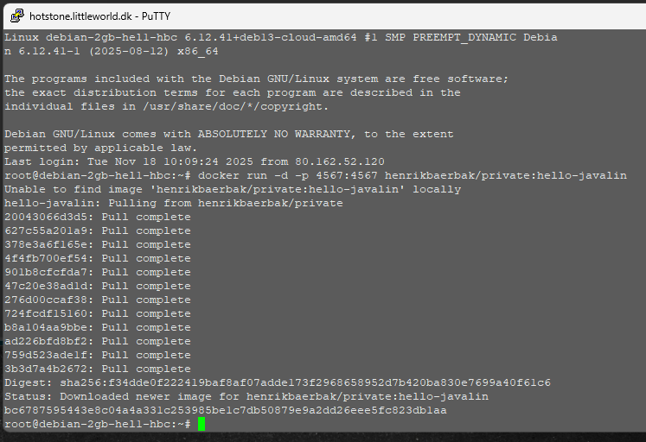
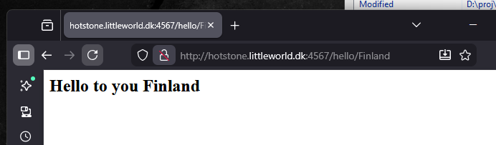
Process
Log into my machine in Helsinki
  Using my Windows Putty secure shell; and ‘run’ container
    Ah – also open port 4567 in the firewall ☺
Try it ☺

Slide 23
Bottomline
It takes about 1 minute!
My Helsinki machine does not have neither Java nor Gradle, nor Go, nor Erlang, nor Rust, nor C++… installed
And it can run it all, if they are containerized!

Slide 24
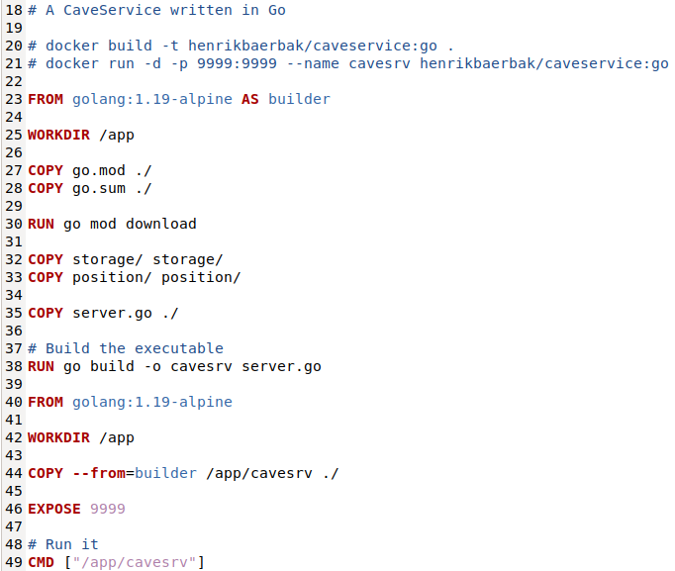
Examples
My ‘cave service’
in GoLang

Slide 25
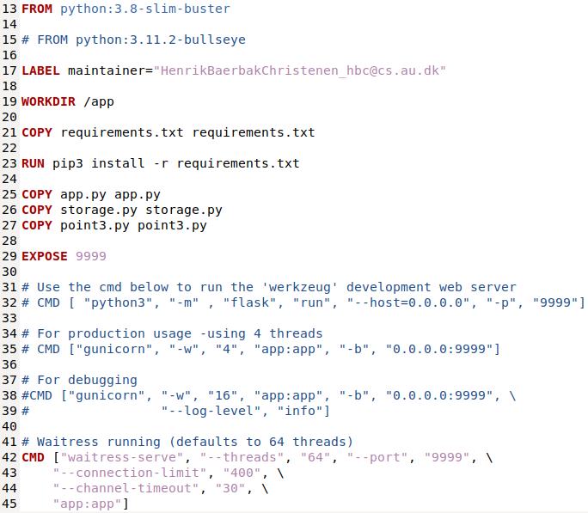
Examples
My ‘cave service’
in Python

Slide 26
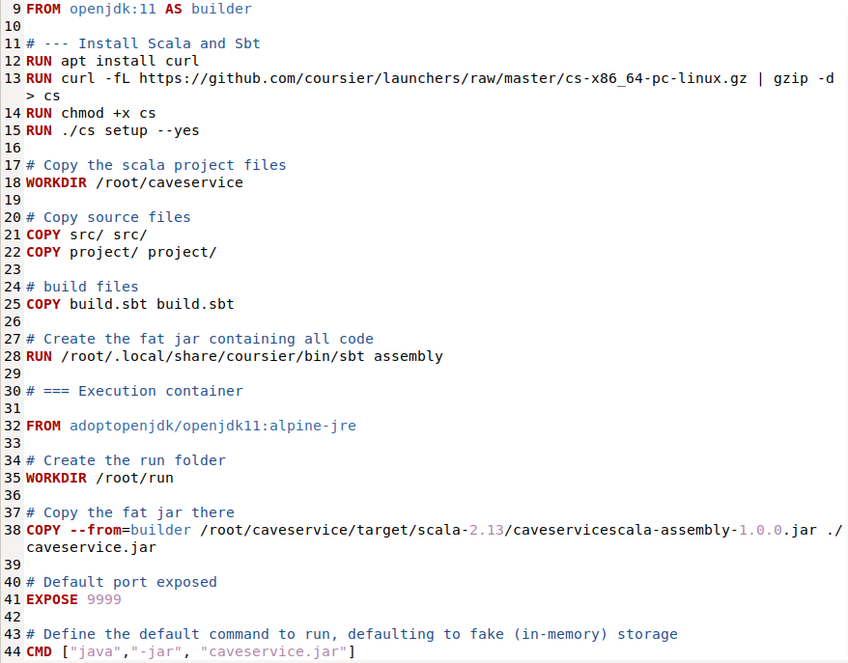
Examples
My ‘cave service’
in Scala

Slide 27
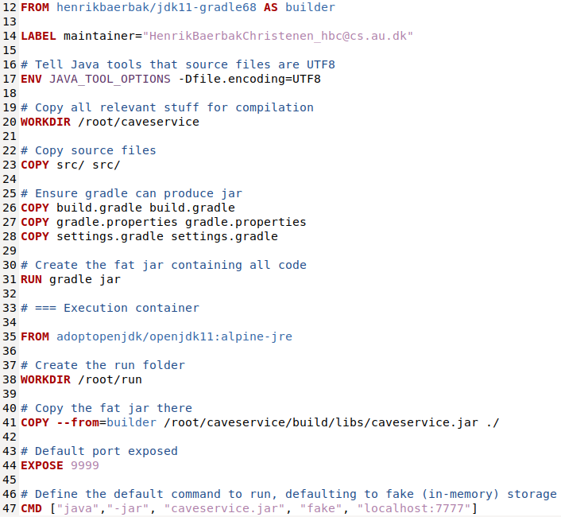
Examples
My ‘cave service’
in Java

Slide 28
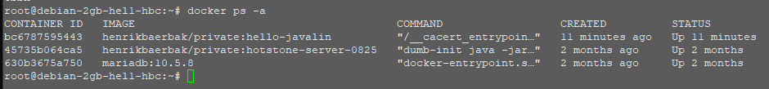
And Much More
My Hetzner machine runs other stuff for me…
The hot stone game server with its associated MariaDB is is running on the machine...

Slide 29

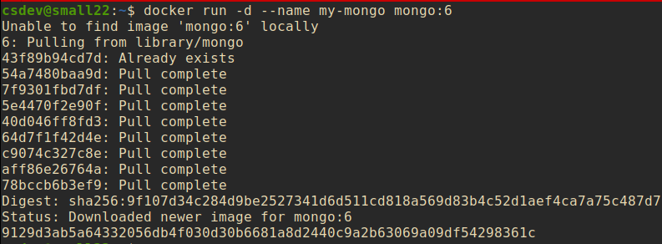
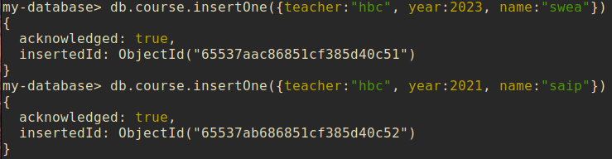
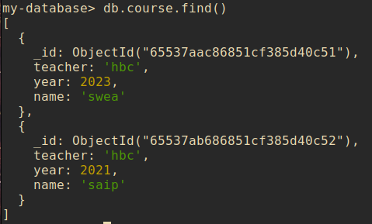
And the World is Big
All major players of open source have containers for their products.
Want to have a MongoDB database?
  Easy! It takes about ½ minute to get it installed and running!

Slide 30
Deploying Systems
Outlook to
Orchestration Tools

Slide 31
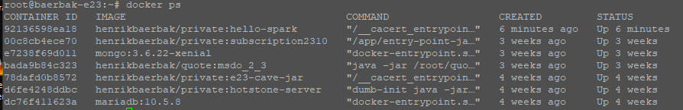
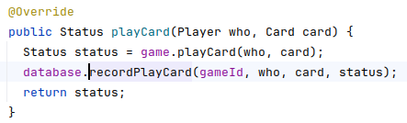
Only one service…
‘docker run …’ allows me to ‘start one service’
But systems in practice need many more services
Ex: HotStone server on hotstone.littleworld.dk
  That server stores all method calls in a SQL database for “future analysis”
  Exercise: What pattern is in play here ☺?

Slide 32
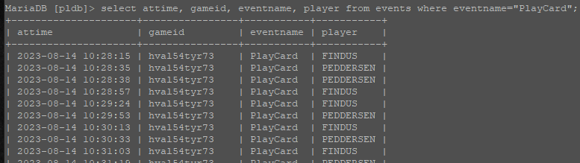
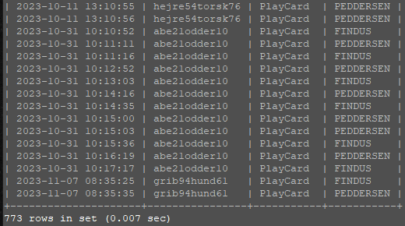
[SideBar]
So I can query like “when was a card played by whom?”

Slide 33
The Problem
I need to deploy
  A MariaDB SQL server container
  A HotStone server
  And ensure they talk to each other (DNS, network)
  Ups – and I need hard disk space for the database itself which survives restarting the system!
    (By default, a container has its own file system (of course), and thus removing it, will destroy all contents!)
We need infrastructure-as-code to deploy systems

Slide 34
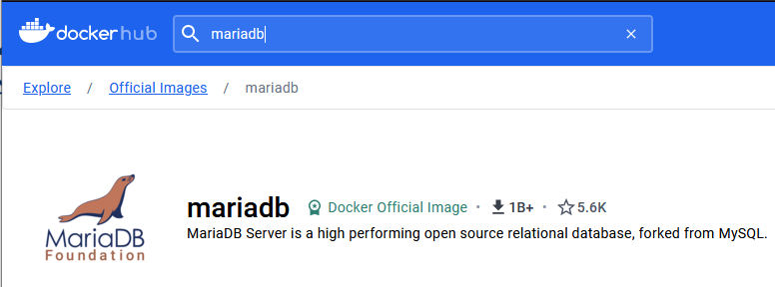
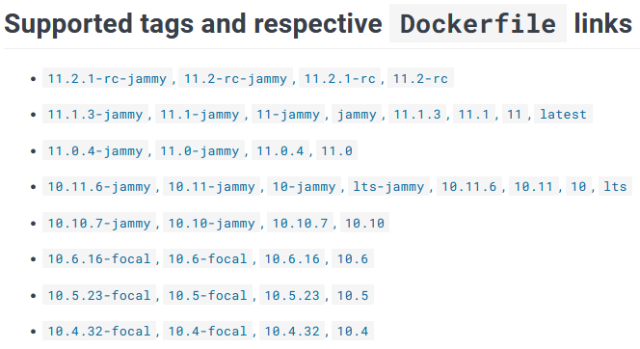
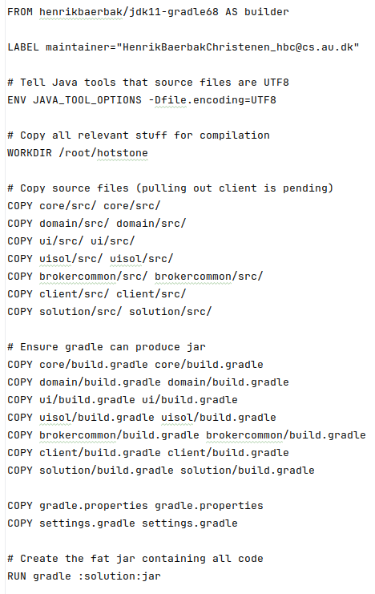
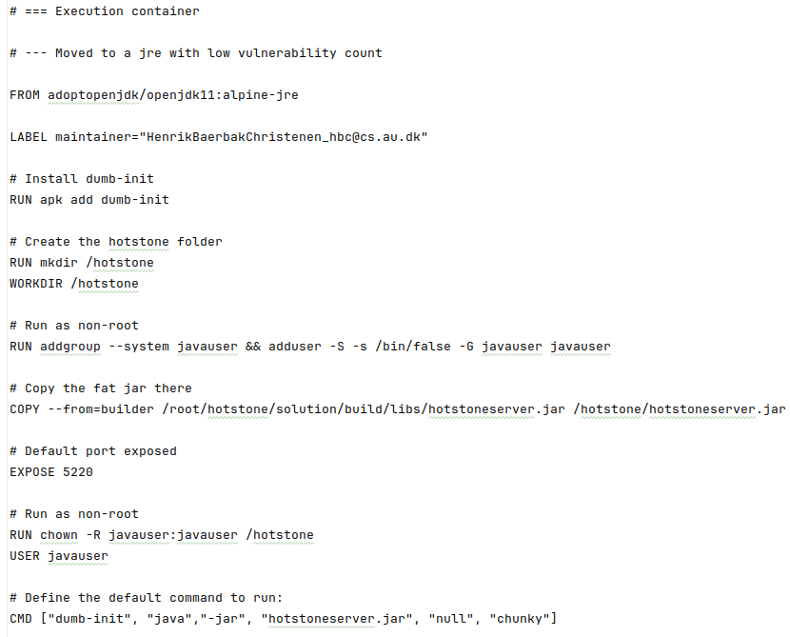
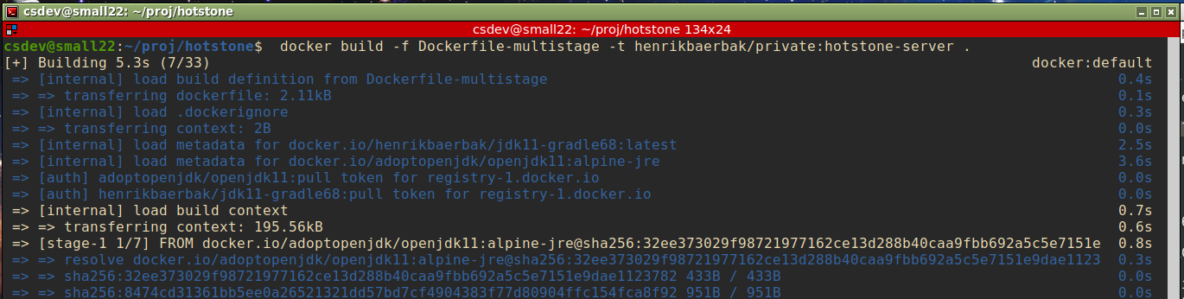
The Containers
A) MariaDB Easy part: Images on Docker Hub
B) HotStone server
  I write a Dockerfile, build container, and push

Slide 35
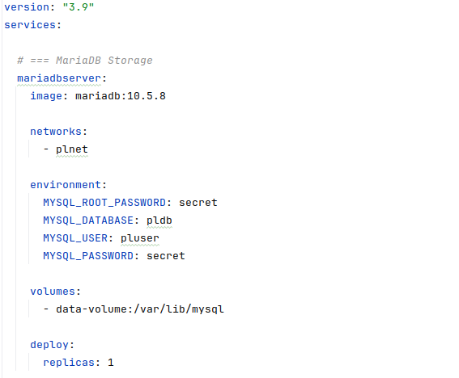
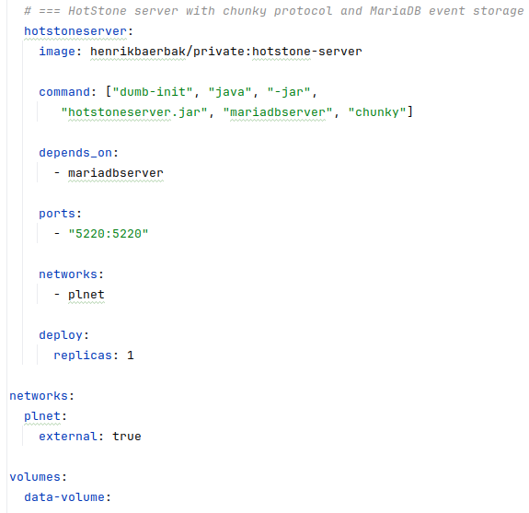
Docker Swarm
IaC for orchestration

Slide 36
Internal Network and DNS
Network ‘plnet’ and Named servers

Slide 37
Volume
Volumes are stored on the host machine

Slide 38
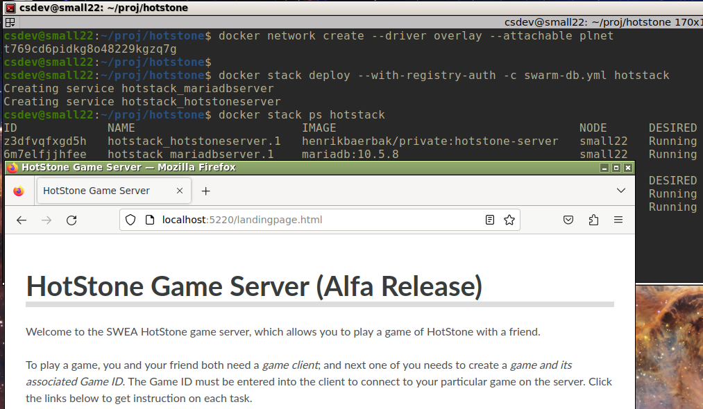
Time to Deploy (Testing)
On my Staging machine, just ‘docker stack deploy’

Slide 39
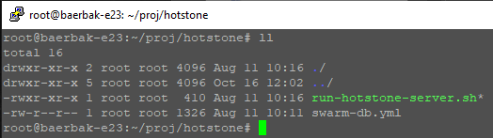
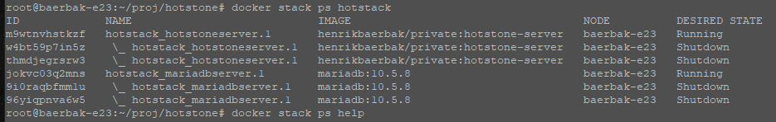
Time to Deploy (Production)
On my cloud machine, the only contents is the IaC
    The ‘run…’ script is just the ‘docker stack deploy…’ command

Slide 40
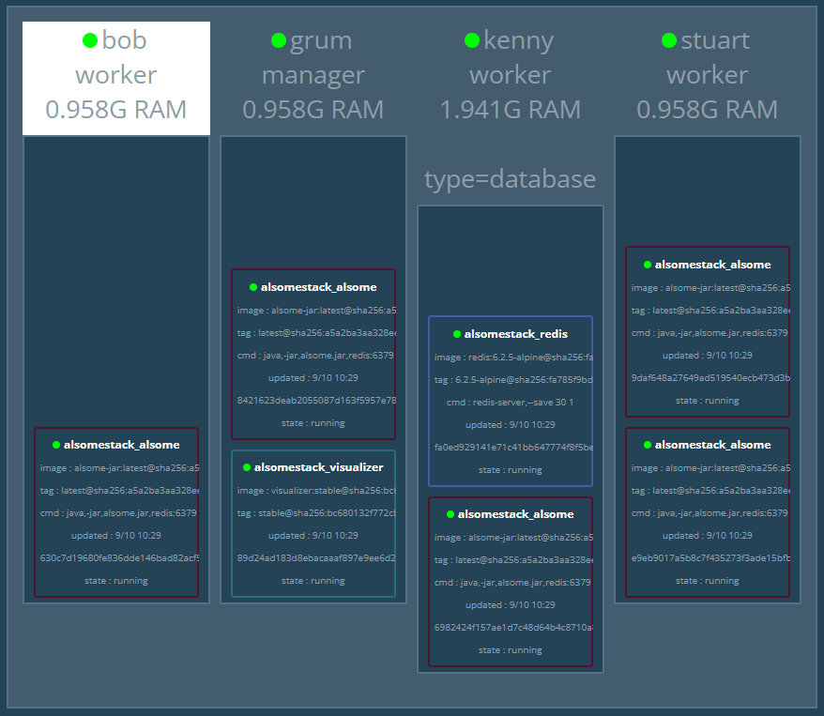
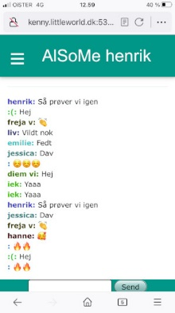
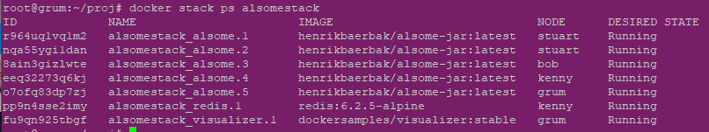
Scaling Out
Swarm is a swarm
  Four machines in my swarm
    Grum, bob, stuart, kenny
Automatically deploys…
  Redis database
  Five ‘alsome’ servers
  One visualizer service

Slide 41
Summary
This is not SWEA curriculum
  No exam questions, no questioning at the exam
  Beyond our ‘software architecture in the small’ focus of SWEA
But…
  It is an important conceptual framework and tool stack to master for large scale, industrial, software development and operations.
Swarm is not widely used (Docker containers are!)
  The big player is Kubernetes
  From a conceptual point of view, they are the ‘same thing’…
    An orchestration tool…

